Slide 1




How Cloud Native Impacts your Development, Deployment and Operations
Steve Lasker
Program Manager
Azure Container Registries
Steve.Lasker@Microsoft.com
@SteveLasker
SteveLasker.blog
github.com/SteveLasker
github.com/SteveLasker/presentations

Slide 2
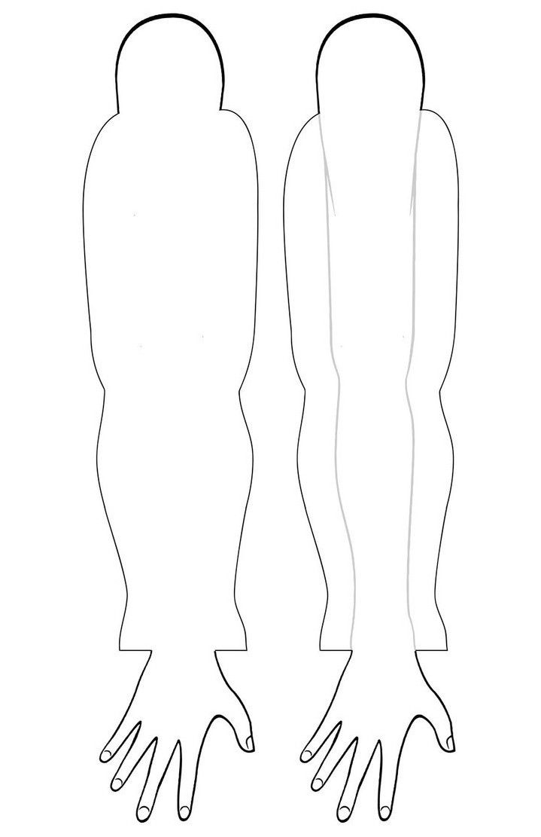
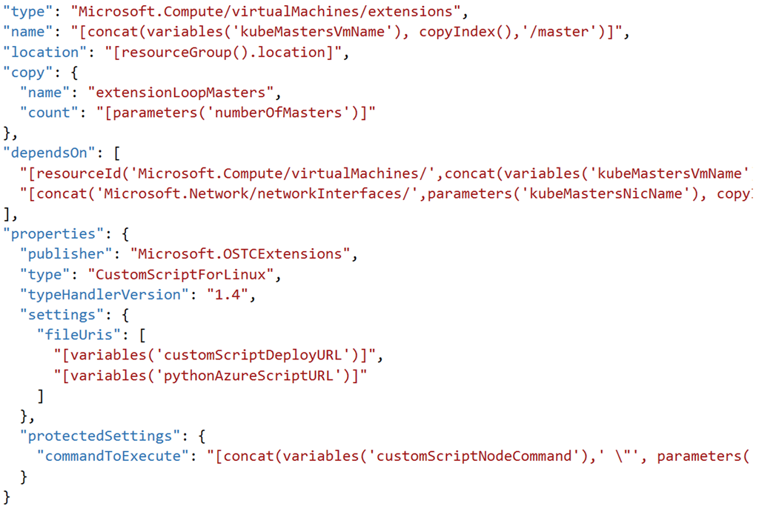
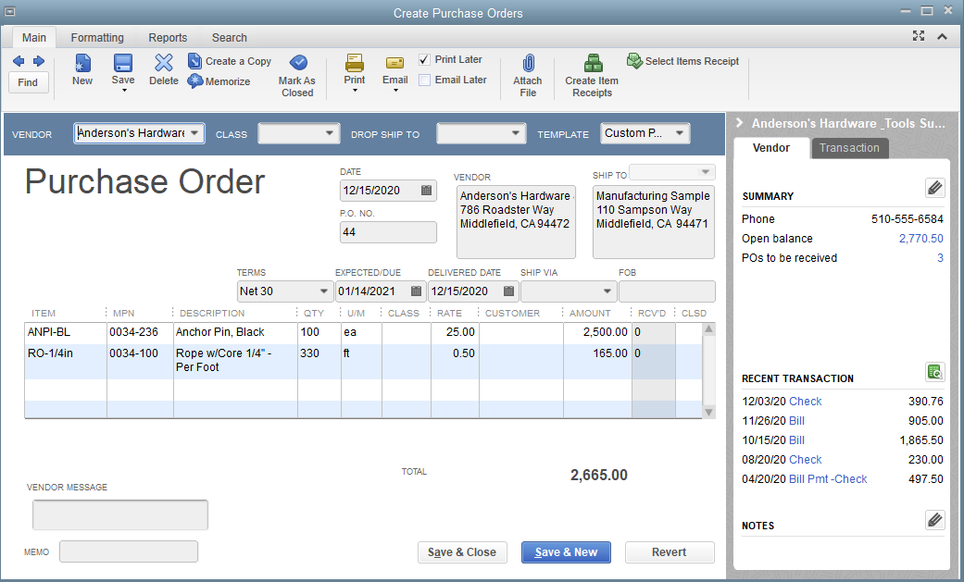
Provisioning Environments
With Documents & Shipping Companies
With APIs

Slide 3
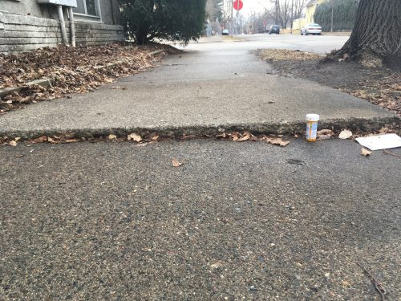


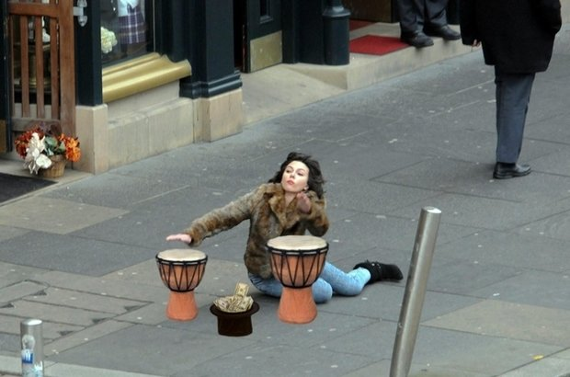
Container Orchestration & Reliability
Designing with the knowledge something will fail at any point

Slide 4



Orchestration Provides Infrastructure Resiliency
Release Management
Resource Pool
Orchestration
HOST-A
Deploy:
web:1 x3
quotes:1 x3
important:1 x4
Image Cache
3
web:1
digest: 91e
web:1
digest: 91e
Foo:
web:1 x3
quotes:1 x3
important:1 x4
web:1
digest: 91e
quotes:1
digest: u82
Container Builder
important:1
digest: 2re
important:1
digest: 2re
Container Registry
HOST-B
Image Cache
quotes:1
digest: u82
quotes:1
digest: u82
7
6
quotes:1
digest: u82
5
web:1
digest: 91e
important:1
digest: 2re
important:1
digest: 2re
important:1
digest: 2re
quotes:1
digest: u82
1
quotes:1
digest: u82
docker build –t web:1
docker build –t quotes:1
docker build –t important:1
docker push web:1
docker push quotes:1
docker push important:1
important:1
digest: 2re
important:1
digest: 2re
Image
web:1
quotes:1
important:1
2
Digests
91e
u82
2re
web:1
digest: 91e
HOST-C
quotes:1
digest: u82
4
important:1
digest: 2re
8
Image Cache
quotes:1
digest: u82
quotes:1
digest: u82
important:1
digest: 2re
important:1
digest: 2re
Notes:
Orchestrator icon from: http://cdn.marketplaceimages.windowsphone.com/v8/images/f58edb21-b20c-4315-b837-6cee21n442cd?imageType=ws_icon_large
https://git-scm.com/book/en/v2/Git-Branching-Basic-Branching-and-Merging

Slide 5

Securing Container Workflows

Slide 6
Securing Container Workflows
Registry access limited through granular roles ^{(push, pull, delete, …)}
Repository scoped RBAC
Restrict image:tag updates with Repository & Tag Locking
Building images securely with ACR Tasks
Signing Images with Content Trust
Build cache is secured with Premium Files
Build artifacts encrypted at rest within ACR
Artifacts are quarantined, pending scanning
Scan results surfaced in ACR
Registry endpoint restricted through VNet & Firewall Rules

Slide 7


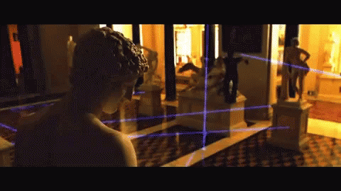
Security isn’t definitive it’s a matter of time, effort and how determined someone is.

Slide 8

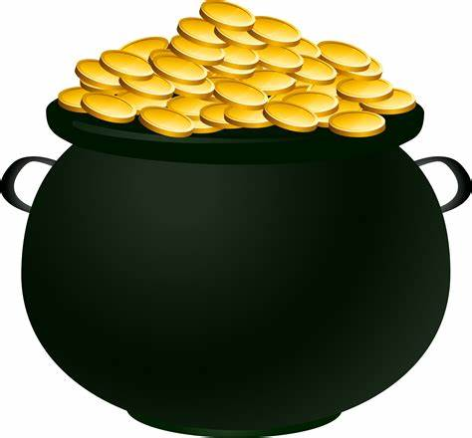
Multiple Lines Of Defense

Slide 9





Authentication & Authorization
Require the most stringent authentication
Users – 2fa
Services – rotatable, revocable, time-based tokens
Provide the least permissions required to get the job done.
Runtime clusters should only be able to pull
CI Systems should be able to push
Teams & clusters should have different permissions
Who can sign images?
Authentication:
Username/Password?
2FA
Token
Certificate
Time based
Revocable?
Permissions:
Read – Pull
Write – Push
Sign – content trust
List – repos and tags
Delete
Update meta-data – expiration date
Users
Services

Slide 10

Managing Base Images

Slide 11

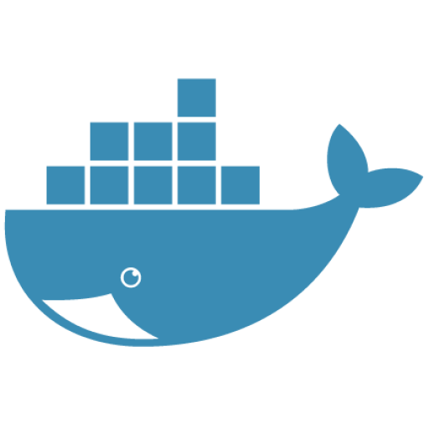





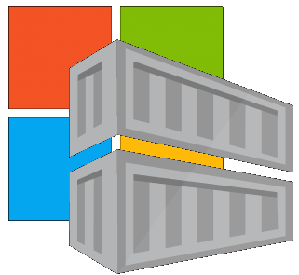




Are Your Base Images Secure?
Buffer base artifacts in your secured environment
Scan, test, validate base artifacts
Automate all of this
Be protected and available, when things outside your control aren’t secured or available
Are Your Base Images Artifacts Secure?
Public Registries
Your Environment
aws, azure, google, on-prem, …
Private Registry
acr, ecr, gcr, dtr, harbor, jfrog, …
.NET
contoso.azurecr.io
Docker Hub
Public Internet
staging-artifacts
node
java
MCR
dotnet
ACR Tasks
wordpress
base-artifacts
node
java
dotnet
wordpress
departments
marketing
warranty
dev
falcon-team
warriors-team

